Slide 1
Stock Prediction App
July 2022
Session 2
UX Design Team
Dennis UX Design Students

Slide 2
Table of Contents
Section 1 Brief Review
Section 2 Design Changes
Section 3 Recommendations
Section 4 Next Steps

Slide 3
Brief Review

Slide 4
Project Background
We are creating a stock prediction app using machine learning models which has study and process the stock data to allow users to find out what is the stock level in future.
Session 1 Highlights
The session presented the usability studies, user feedbacks and insights.

Slide 5
Design Changes

Slide 6
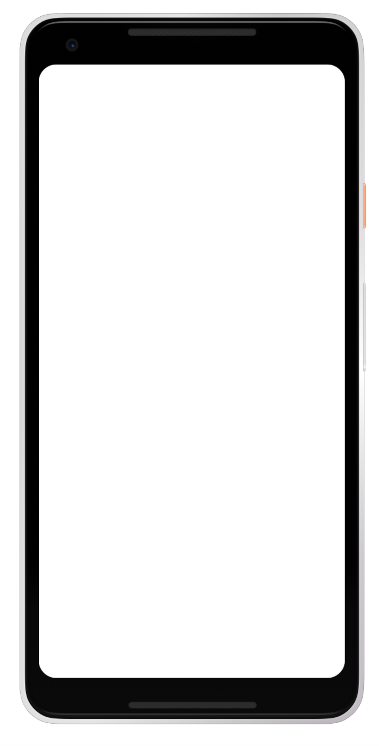
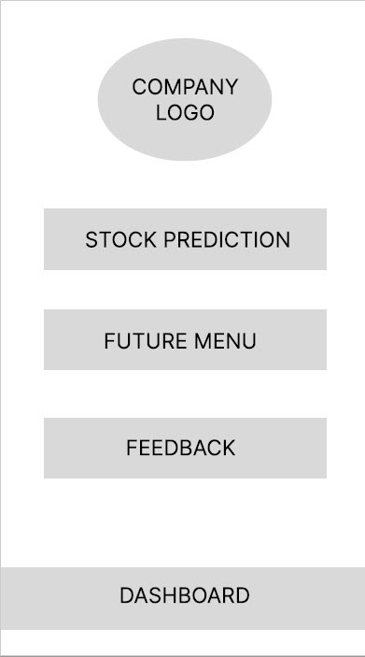

Prototype / Design Tested
This is a screenshot of main menu

Slide 7
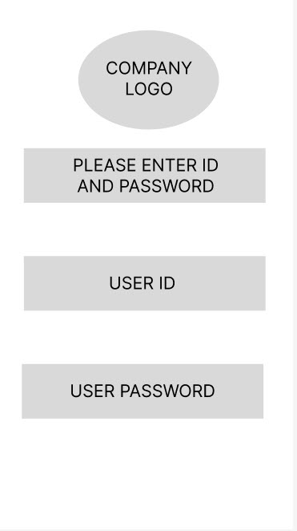
Login and Password Issues
Old Design
a

Slide 8
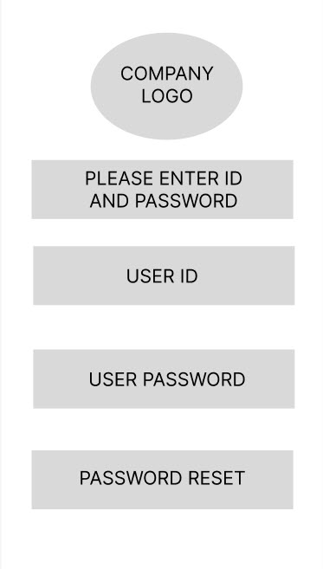
Login and Password Issues
Supporting evidence from the usability study.
5 out of 5 total participants said they are concerned with login issues and lost/forgot password
Redesigned to add in Password Reset option
“It will be good to add in password reset as I may forgot my password in future.” (P2)
a

Slide 9
Stock Data Input
Old Design - None at that time
a

Slide 10
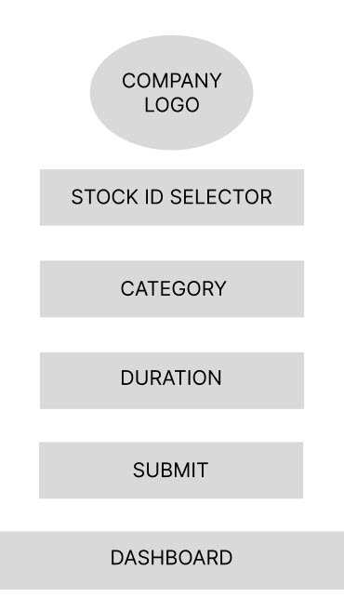
Stock Data Input
Supporting evidence from the usability study.
Data stock entries can be time consuming
New Design for single stock entry as pilot project
More options will be added in future versions
“I am spending too much time looking and typing the particular stock.” (P4)
a

Slide 11
Recommendations

Slide 12
Recommendations
Brainstorm ideas for solving data entry issues
Research on other similar applications if there is
Enhance feel and look factor

Slide 13
Next Steps

Slide 14
Next Steps
Have another round of usability studies conducted in August
Incorporate P1 changes into the app
Continue to receive suggestions and feedback from users

Slide 15
Thank you!
All credit goes to UX Team!

